Slide 1
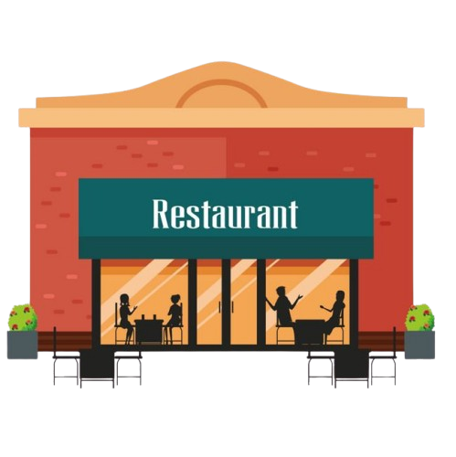


Restaurant Management System
Admin have to log in with valid admin id & password
User have to log in with Name & Mobile no
Admin Login
User Login
Add Menu Delete Menu Modify Menu View All Orders Day wise Profit
View Menu Add items to Cart Modify cart Bill
Show day wise Profit
View All Order Details
Give Itemised bill
Modify items from menu
Modify cart like modify Quantity& delete items
Delete item from Menu
Add items to cart
Adding items like Veg, Non-veg, Starters, Biriyanis,…ect
View All the Menu like Starters, Biriyanis, cooldrinks
Store all the items data in database

Slide 2
Documentation
I. User Login
1. Log In: Users log in with their name and mobile number.
2. View Menu: Users can view the full menu, including starters, biryanis, and cold drinks.
3. Add Items to Cart: Users can add selected menu items to their cart.
4. Modify Cart: Users can modify their cart by adding, deleting, or changing item quantities.
5. Bill: After finalizing the cart, users receive an itemized bill.
II. Admin Login
1. Log In: Admins log in using an admin ID and password.
2. Add Menu: Admins can add new items to the menu.
3. Delete Menu: Admins can remove items from the menu.
4. Modify Menu: Admins can update details of existing menu items.
5. View All Orders: Admins have access to a list of all user orders.
6. View All Order Details: Admins can view detailed information for each order, including customer info and itemized details.
7. Day Wise Profit: Admins can view and analyze daily profit generated by the restaurant.
8. Modify Items From Menu: Admins can edit details of existing menu items or add new ones.
9. Delete Item From Menu: Admins can delete specific items from the menu if they are unavailable.

Slide 3
Table Format to store Menu
Sno | Item Name | Price
Table Format to Store User Details
Sno | User Name | Mobile no | Bill

